Slide 1




Slide 2

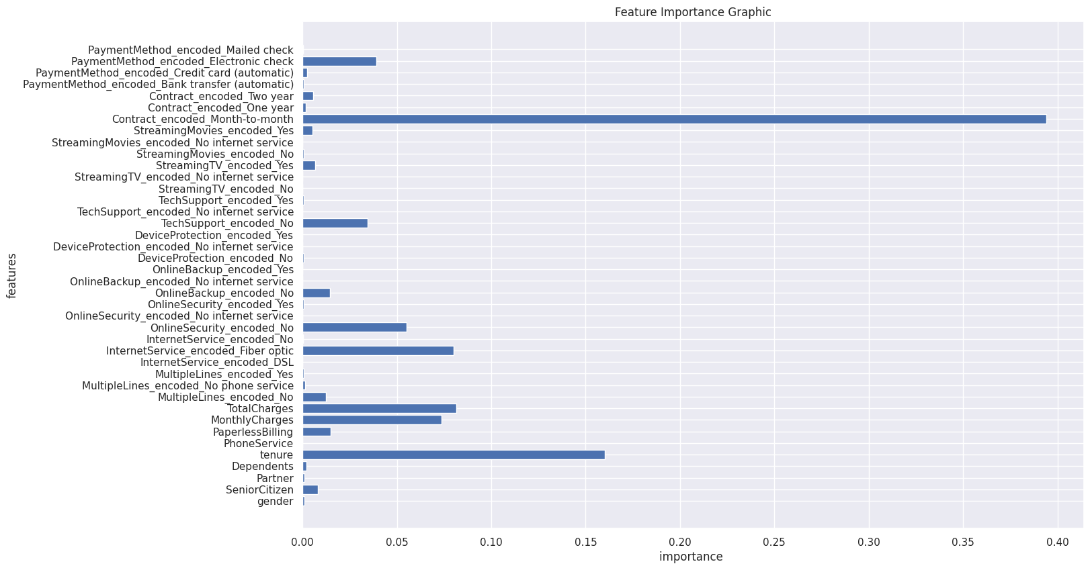
Feature Importance – Gradient Boosting Classifier

Slide 3
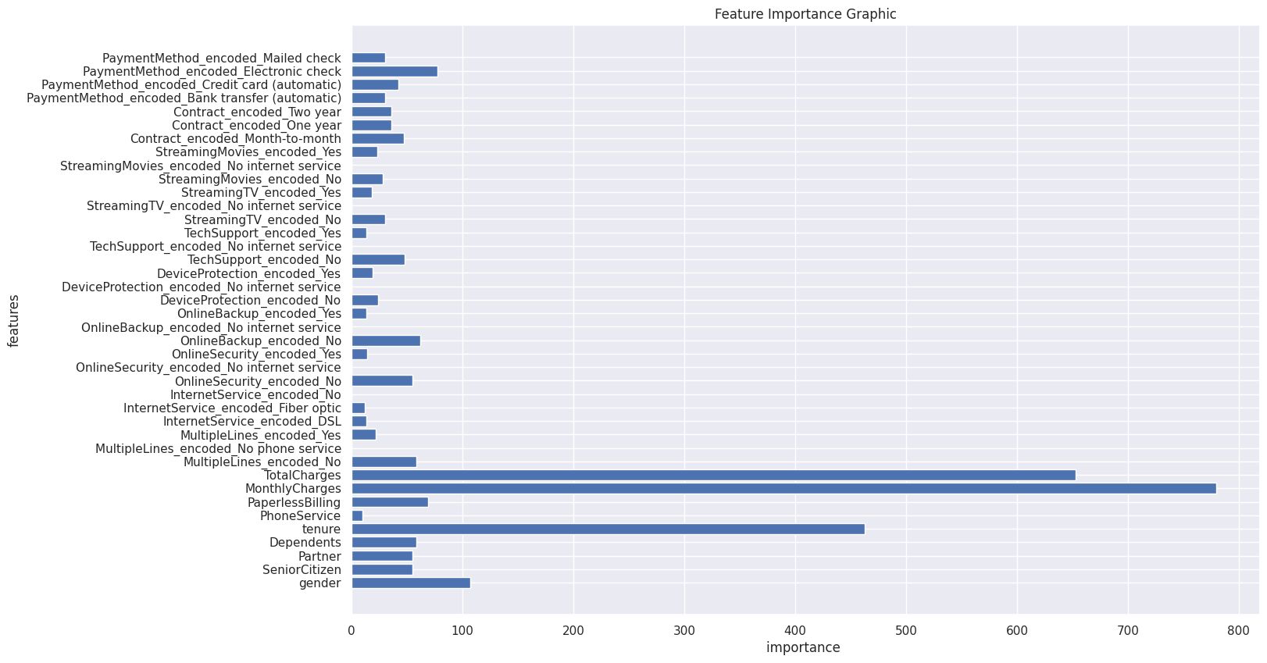
Feature Importance – Light GBM

Slide 4



Internet Service
Streaming Movies
Contract

Slide 5
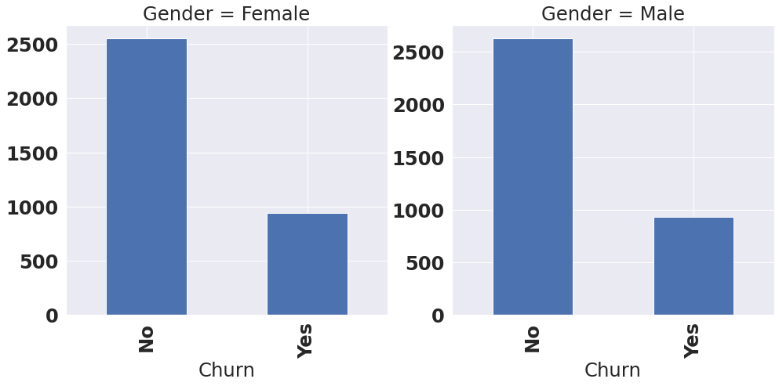
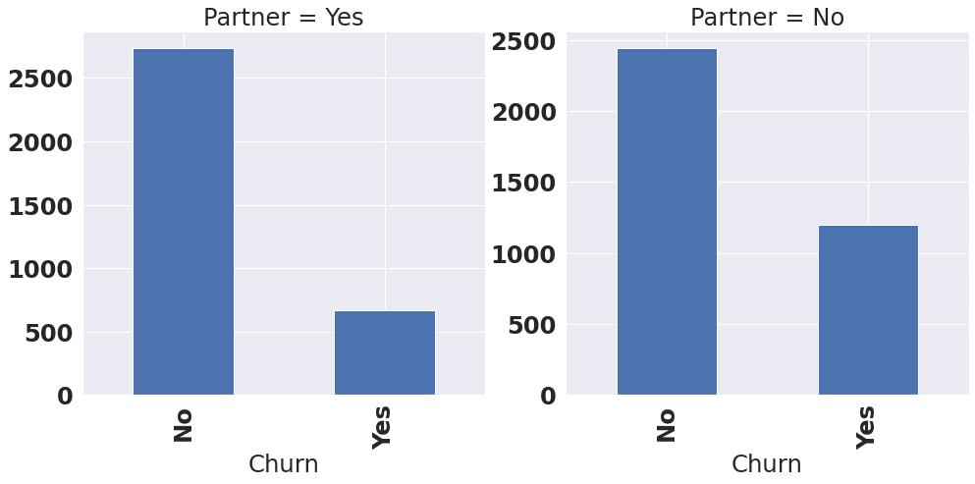
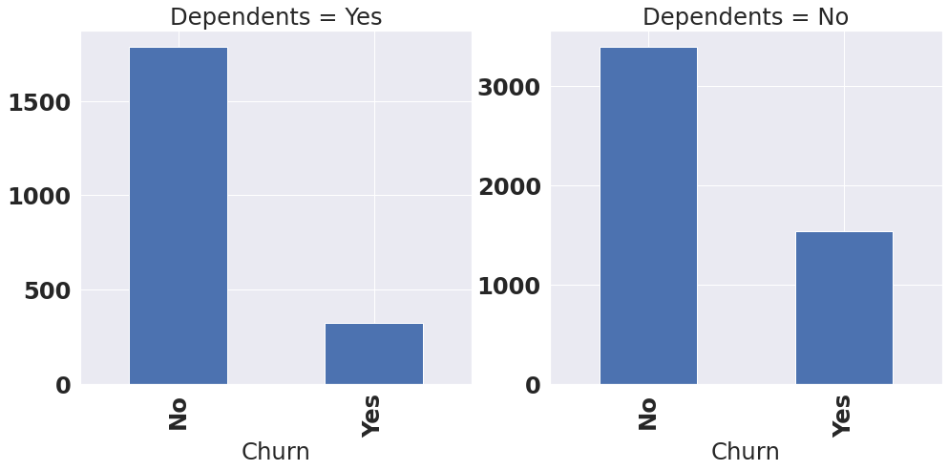
Gender
Partner
Dependents

